Slide 1
Vector Spaces & Subspaces

Slide 2
Vector Spaces & Subspaces
Vector Spaces: Definition Vector Spaces: Examples
2 × 2 matrices Polynomials
Subspaces: Definition Subspaces: Examples Determining Subspaces

Slide 3
4.1 Vector Spaces & Subspaces
Vector Spaces
Many concepts concerning vectors in R^{n} can be extended to other mathematical systems.
We can think of a vector space in general, as a collection of objects that behave as vectors do in R^{n}. The objects of such a set are called vectors.
Vector Space
A vector space is a nonempty set V of objects, called vectors, on which are defined two operations, called addition and multiplication by scalars (real numbers), subject to the ten axioms below. The axioms must hold for all u, v and w in V and for all scalars c and d .
u + v is in V .
u + v = v + u.

Slide 4
4.1 Vector Spaces & Subspaces
Vector Spaces (cont.)
Vector Space (cont.)
3.( u + v) + w = u + (v + w)
4.There is a vector (called the zero vector)
u + 0 = u.
0 in V such that
For each u in V , there is vector −u in V satisfying
u + (−u) = 0.
cu is in V .
c(u + v) =cu+cv.
8.( c + d )u = cu + d u.
9.( cd )u = c(d u).
10.1 u = u.

Slide 5
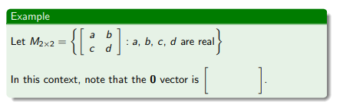
4.1 Vector Spaces & Subspaces
Vector Spaces: Examples

Slide 6
4.1 Vector Spaces & Subspaces
Vector Spaces: Polynomials
Example
Let n ≥ 0 be an integer and let
P_{n} = the set of all polynomials of degree at most n ≥ 0.
Members of P_{n} have the form
p(t) = a₀ + a₁t + a₂t² + · · · + a_{n}t^{n}
where a₀, a₁, . . . , a_{n} are real numbers and t is a real variable. The set P_{n} is a vector space.
We will just verify 3 out of the 10 axioms here.
Let p(t) = a₀ + a₁t + · · · + a_{n}t^{n} and q(t) = b₀ + b₁t + · · · + b_{n}t^{n}. Let c be a scalar.

Slide 7
Vector Spaces: Polynomials (cont.)
4.1 Vector Spaces & Subspaces Vector SpacesSubspacesDetermining Subspaces
Axiom 1:
The polynomial p + q is defined as follows: (p + q) (t) = p(t)+q(t). Therefore,
(p + q) (t) = p(t)+q(t)
= ( ) + ( ) t + · · · + ( ) t^{n}
which is also a of degree at most . So
p + q is in P_{n}.

Slide 8
Vector Spaces: Polynomials (cont.)
4.1 Vector Spaces & Subspaces Vector SpacesSubspacesDetermining Subspaces
Axiom 4:
0 =0 + 0t + · · · + 0t^{n} (zero vector in P_{n})
(p + 0) (t)= p(t)+0 = (a₀ + 0) + (a₁ + 0)t + · · · + (a_{n} + 0)t^{n}
= a₀ + a₁t + · · · + a_{n}t^{n} = p(t) and so p + 0 = p

Slide 9
Vector Spaces: Polynomials (cont.)
Axiom 6:
(cp) (t) = cp(t) = ( ) + ( ) t + · · · + ( ) t^{n} which is in P_{n}.
The other 7 axioms also hold, so P_{n} is a vector space.

Slide 10
4.1 Vector Spaces & Subspaces
Subspaces
Vector spaces may be formed from subsets of other vectors spaces. These are called subspaces.
Subspaces
A subspace of a vector space V is a subset H of V that has three properties:
The zero vector of V is in H.
For each u and v are in H, u + v is in H. (In this case we say H is closed under vector addition.)
For each u in H and each scalar c, cu is in H. (In this case we say H is closed under scalar multiplication.)
If the subset H satisfies these three properties, then H itself is a vector space.

Slide 11
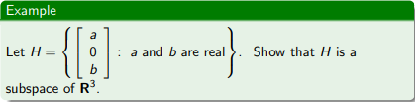
4.1 Vector Spaces & Subspaces
Subspaces: Example
Example
Solution: Verify properties a, b and c of the definition of a subspace.
The zero vector of R³ is in H (let a = and b = ).
Adding two vectors in H always produces another vector whose second entry is and therefore the sum of two vectors in H is also in H. (H is closed under addition)
Multiplying a vector in H by a scalar produces another vector in
H (H is closed under scalar multiplication).
Since properties a, b, and c hold, V is a subspace of R³.

Slide 12
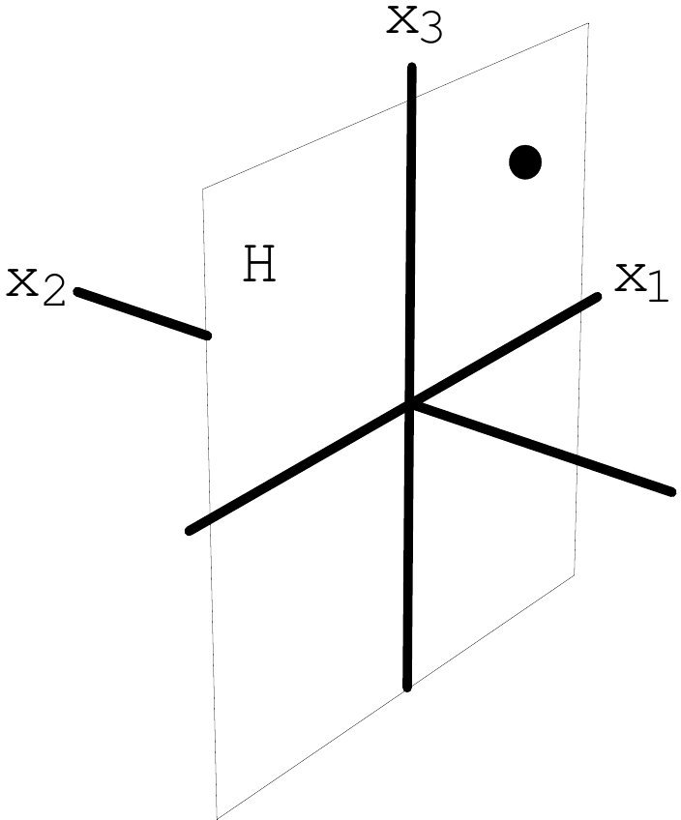
4.1 Vector Spaces & Subspaces
Subspaces: Example (cont.)
Note
Vectors (a, 0, b) in H look and act like the points (a, b) in R².
Graphical Depiction of H

Slide 13
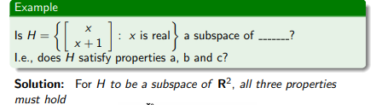
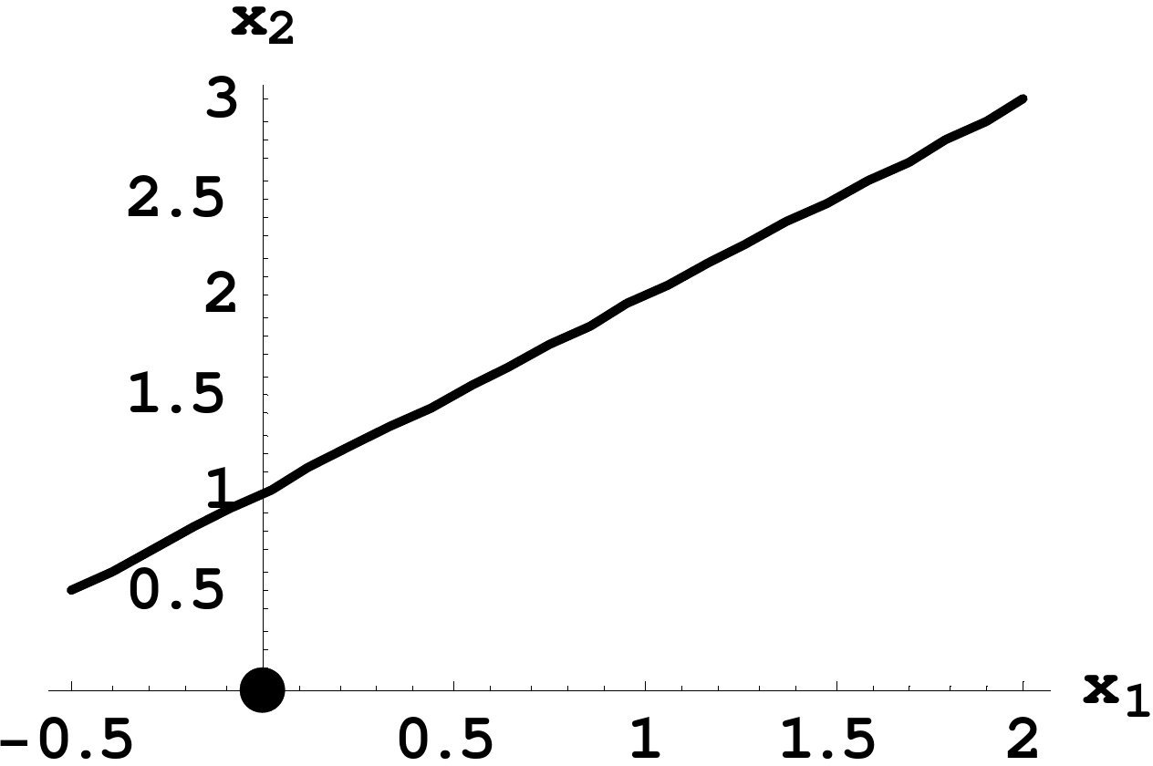
4.1 Vector Spaces & Subspaces
Subspaces: Example
Example
Property (a) fails
Property (a) is not true because . Therefore H is not a subspace of R².

Slide 14
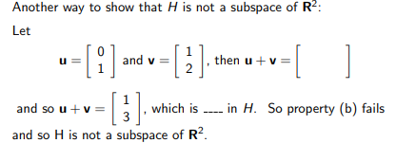
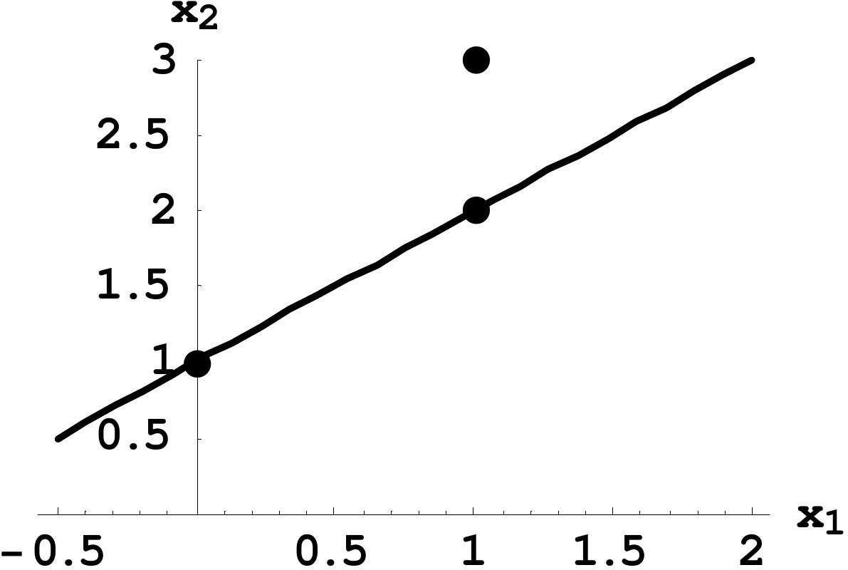
4.1 Vector Spaces & Subspaces
Subspaces: Example (cont.)
Property (b) fails

Slide 15
A Shortcut for Determining Subspaces
Theorem (1)
If v₁, . . . , v_{p} are in a vector space V , then Span{v₁, . . . , v_{p} } is a subspace of V .
Proof: In order to verify this, check properties a, b and c of definition of a subspace.
0 is in Span{v₁, . . . , v_{p} } since
0 = v₁ + v₂ + · · · + v_{p}
To show that Span{v₁, . . . , v_{p} } closed under vector addition, we choose two arbitrary vectors in Span{v₁, . . . , v_{p} } :
u =a₁v₁ + a₂v₂ + · · · + a_{p} v_{p}
and
v =b₁v₁ + b₂v₂ + · · · + b_{p} v_{p} .
Math 2331, Linear Algebra

Slide 16
A Shortcut for Determining Subspaces (cont.)
4.1 Vector Spaces & Subspaces Vector SpacesSubspacesDetermining Subspaces
Then
u + v = (a₁v₁ + a₂v₂ + · · · + a_{p} v_{p} ) + (b₁v₁ + b₂v₂ + · · · + b_{p} v_{p} )
= ( v₁ + v₁) + ( v₂ + v₂) + · · · + ( v_{p} + v_{p} )
= (a₁ + b₁) v₁ + (a₂ + b₂) v₂ + · · · + (a_{p} + b_{p} ) v_{p} .
So u + v is in Span{v₁, . . . , v_{p} } .
c. To show that Span{v₁, . . . , v_{p} } closed under scalar multiplication, choose an arbitrary number c and an arbitrary vector in Span{v₁, . . . , v_{p} } :
v =b₁v₁ + b₂v₂ + · · · + b_{p} v_{p} .
Math 2331, Linear Algebra

Slide 17
A Shortcut for Determining Subspaces (cont.)
Then
cv =c (b₁v₁ + b₂v₂ + · · · + b_{p} v_{p} )
= v₁ + v₂ + · · · + v_{p} So cv is in Span{v₁, . . . , v_{p} } .
Since properties a, b and c hold, Span{v₁, . . . , v_{p} } is a subspace of
V .

Slide 18
4.1 Vector Spaces & Subspaces
Determining Subspaces: Recap
Recap
1
To show that H is a subspace of a vector space, use Theorem 1.
2
To show that a set is not a subspace of a vector space, provide a specific example showing that at least one of the axioms a, b or c (from the definition of a subspace) is violated.

Slide 19
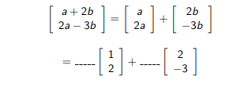
Determining Subspaces: Example
Example
Is V = {(a + 2b, 2a − 3b) : a and b are real} a subspace of R²? Why or why not?
Solution: Write vectors in V in column form:
So V =Span{v₁, v₂} and therefore V is a subspace of by Theorem 1.

Slide 20
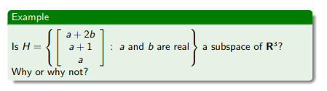
Determining Subspaces: Example
Solution: 0 is not in H since a = b = 0 or any other combination of values for a and b does not produce the zero vector. So property fails to hold and therefore H is not a subspace of R³.

Slide 21
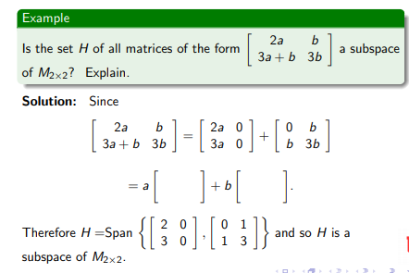
Determining Subspaces: Example

